Slide 1

Metals and non metals

Slide 2

Understand the difference between metals and non-metals.
Describe the properties of metals and non-metals with specific reference to conductivity of heat, electricity and melting point
Define the term alloy & List some examples and uses of alloys in everyday life.
Investigate the properties of metals and non-metals with specific reference to conductivity of electricity

Slide 3
List everyday examples of metals and where they are used

Slide 4
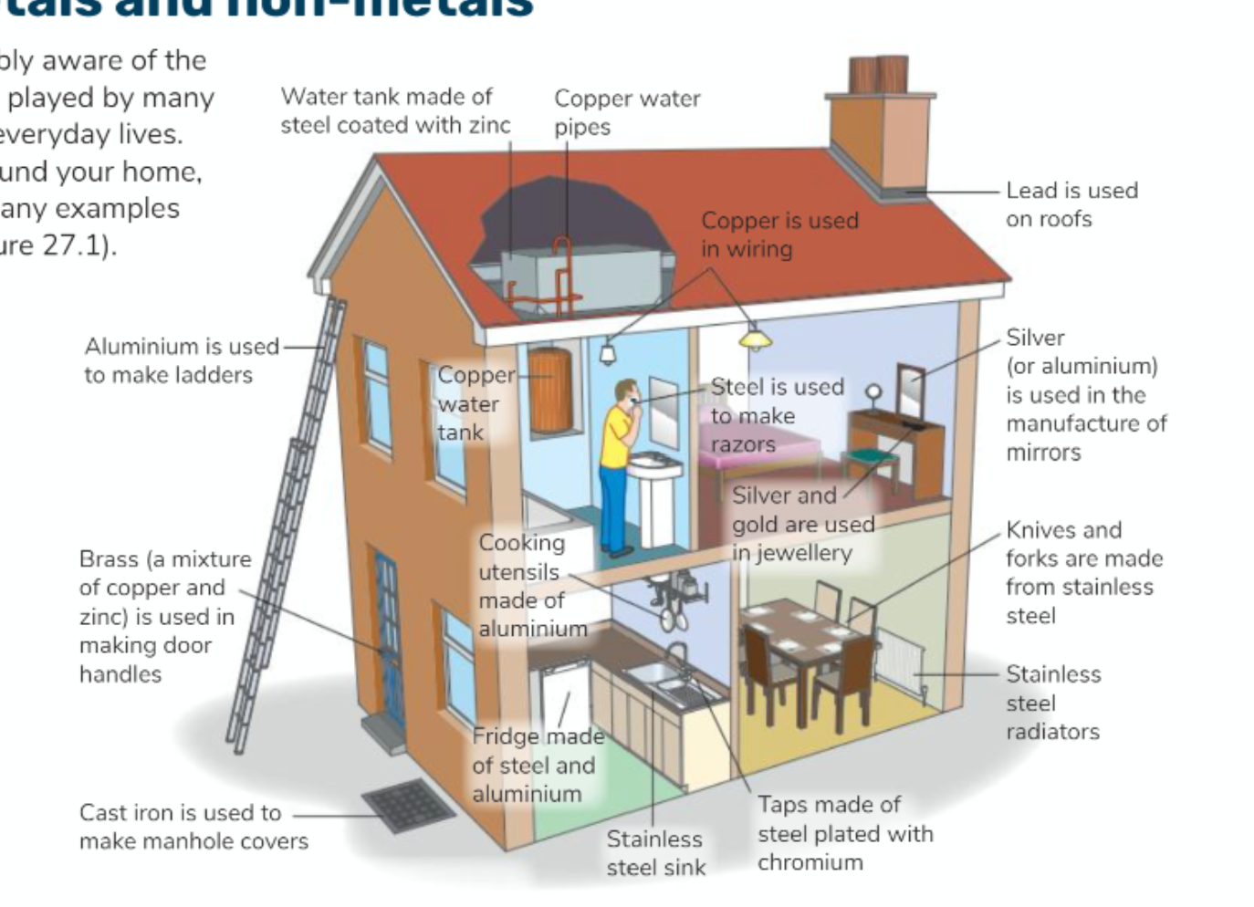

Slide 5
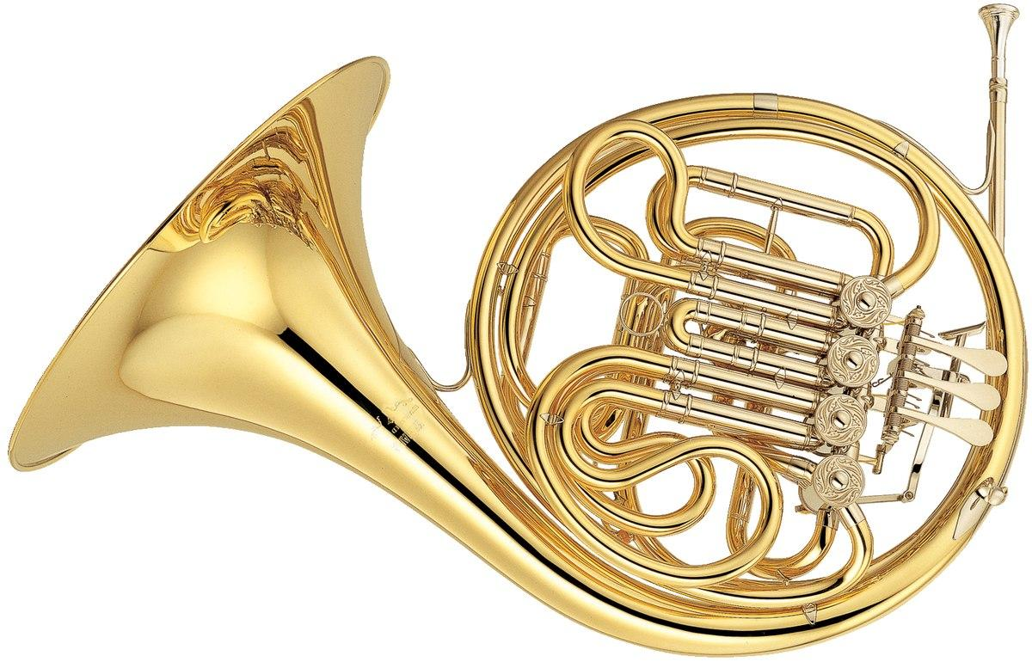
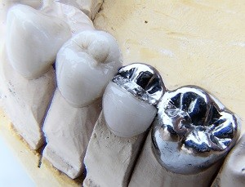

Look at the images below. Decide if the objects are metals or non-metals. Discuss why you think they are metals or not
Notes:
Replacment tooth - titanium
Horn – brass

Slide 6
1. Identify as many uses you can for metal 2. Then state why is metal used for this purpose
E.g. cooking appliances – metal conduct heat
Notes:
Vechiles – don’t break down eaily
Jellwery – shiny
Cooking applances – conduct heat

Slide 7
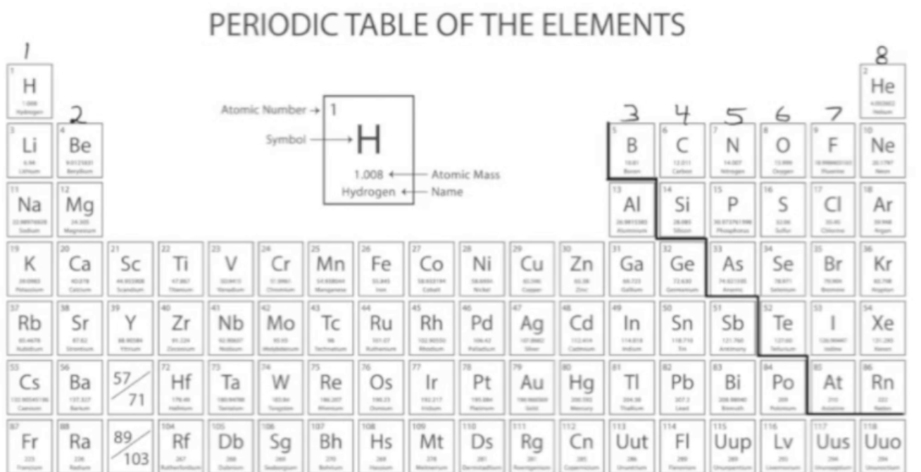
The story
The periodic table consists of metals and non-metals.
Therefore, everything around us can be classified as metals or non-metals.

Slide 8

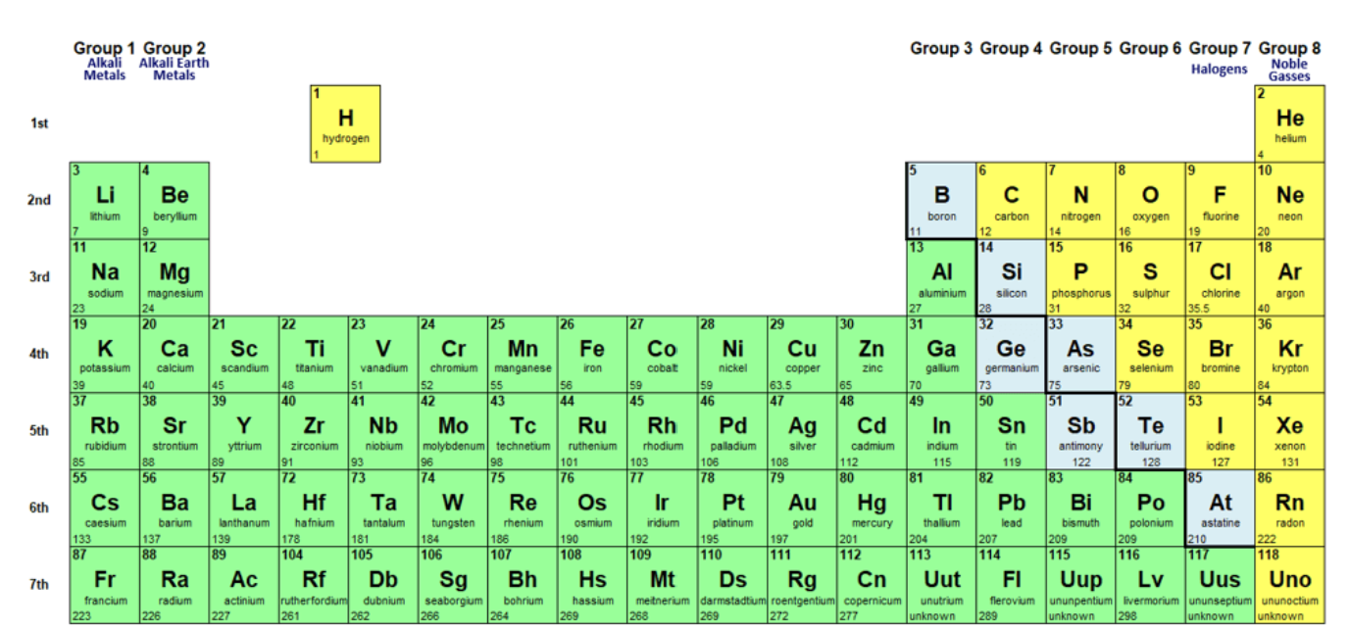
Metals
Metals make up the majority of the elements on the periodic table

Slide 9
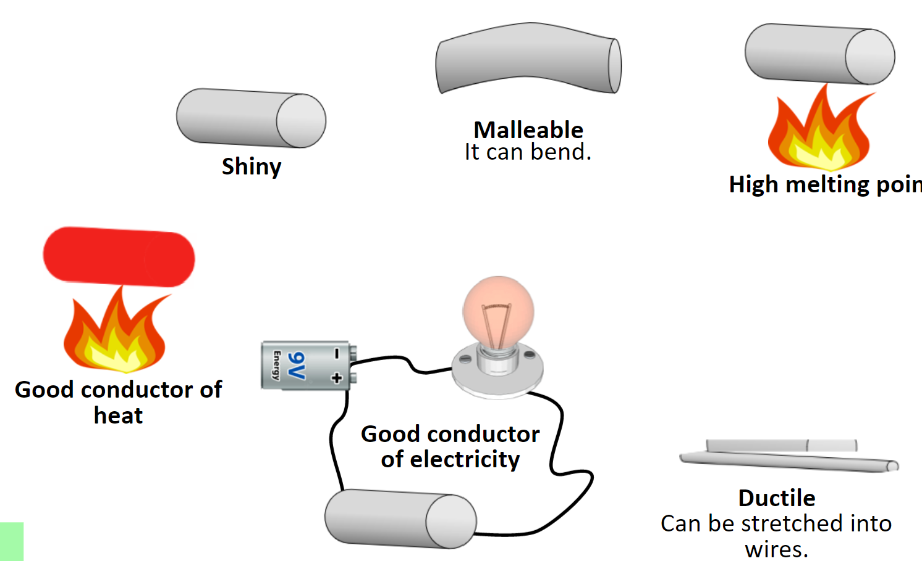
Properties of metals
Properties describe the physical and chemical characteristics of any material
How it looks?
Can it bend?
Can it conduct electricity? All characteristics that can distinguish one material from another

Slide 10
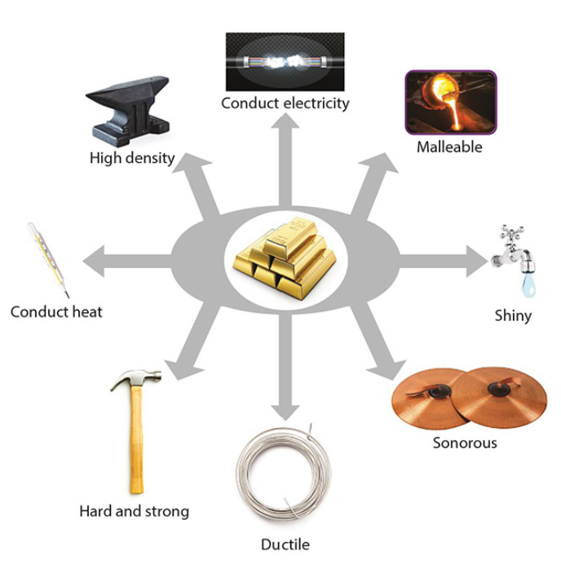
Properties of metals
Notes:
Malleable – hammered into different shapes, al – faltened to tin foil
Ductile – stretched out into wire
Sonorous – produce sound

Slide 11
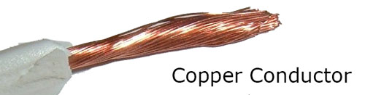
Conduction
A conductor is a substance that allows something to pass through it easily. E.g. heat or electricity.
Metals are excellent conductors

Slide 12
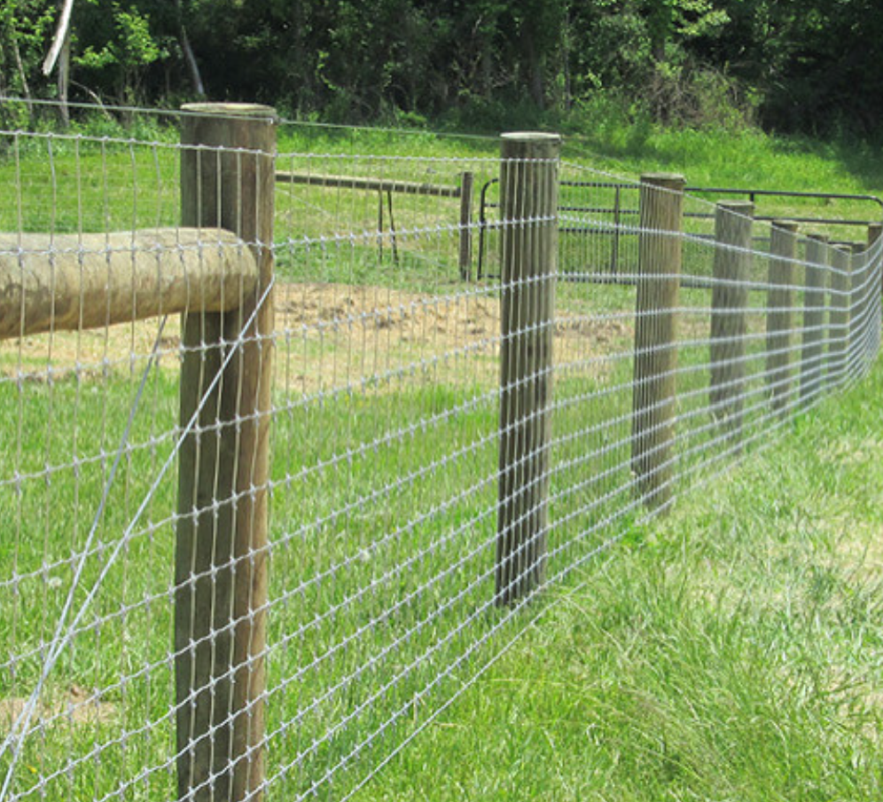
Ductile
A substance that can be stretched into wire

Slide 13

Malleable
A substance that can be hammered into different shapes.
Notes:
https://www.youtube.com/watch?v=Z4fBbhyzE9A

Slide 14

Strong
Used in construction

Slide 15
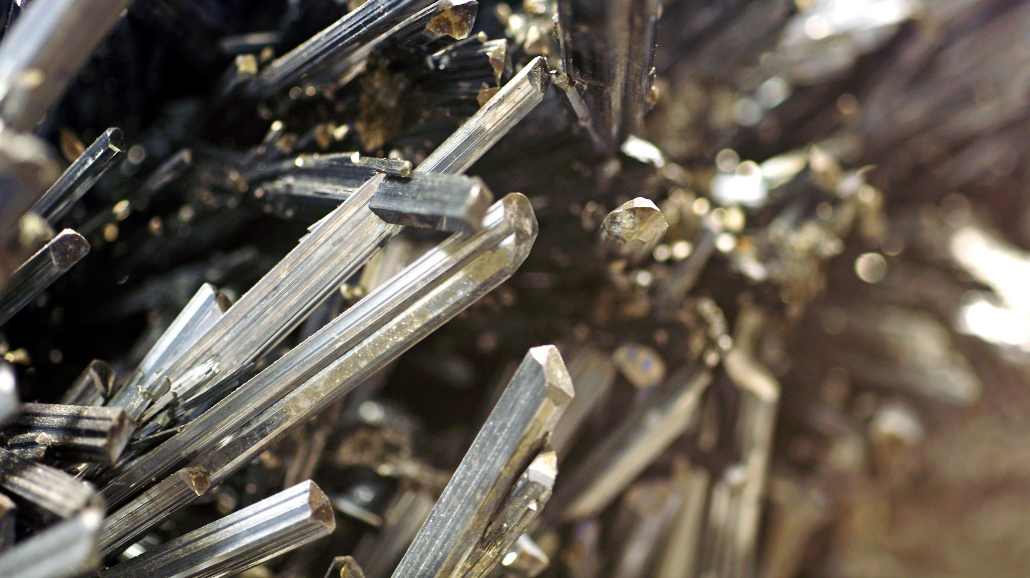
Shiny
Used in jewelry

Slide 16
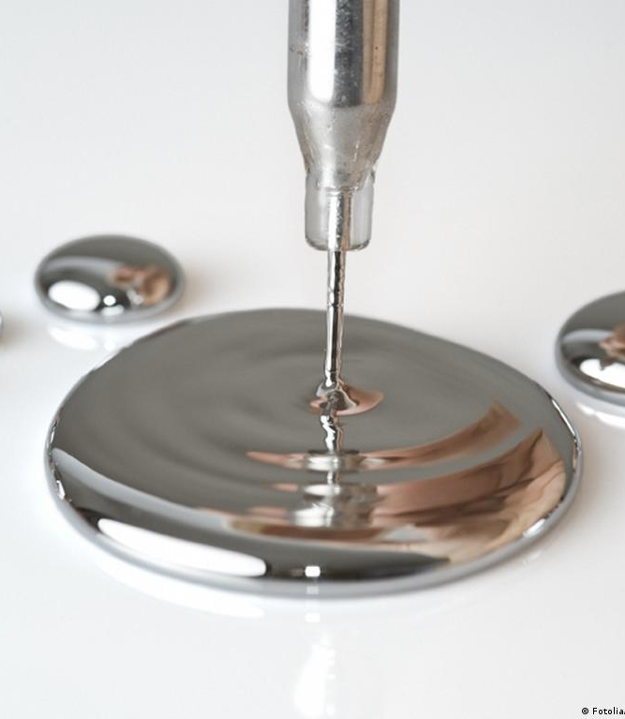
Not all metals have these properties
Mercury is liquid at room temperature
Alkali metals are soft with low density. Eg. Sodium and potassium

Slide 17
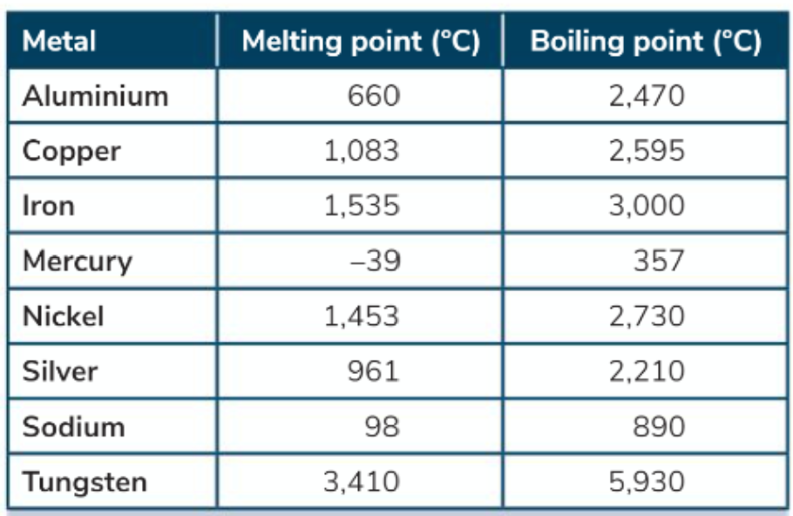
Melting and boiling point of metals
Almost all metals are solid materials with high melting points and boiling points.
However, mercury is liquid at room temperature

Slide 18

Give two reasons why metal, rather than plastic, is a good choice for a saucepan

Slide 19
Research question sources and uses of metals
Chose a metal and find out:
Where is it found as a natural resource.
What is it used for
Any negative effects caused by its extraction and/or use.

Slide 20
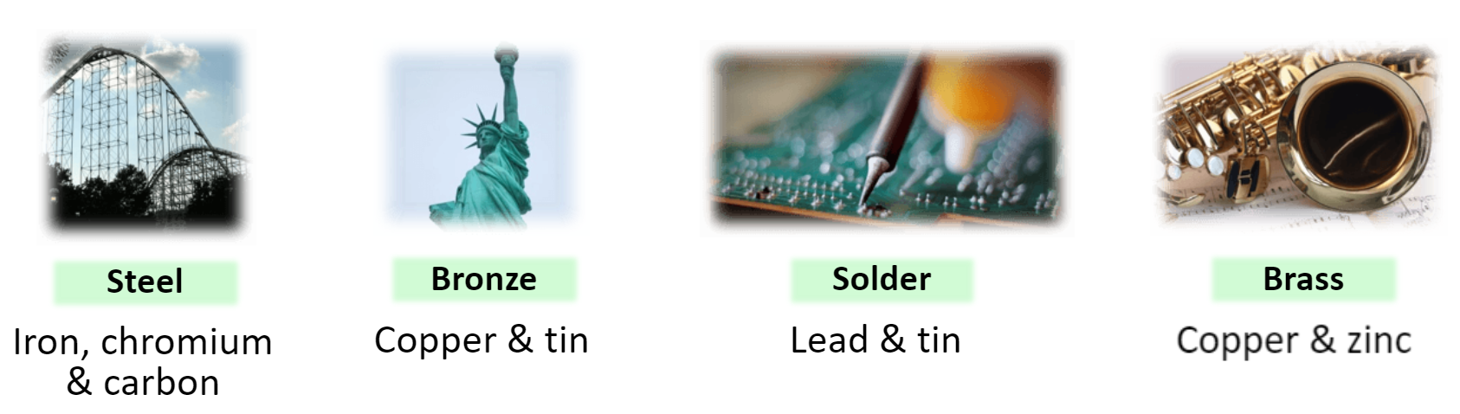
Metals – Alloys
Metals are often mixed together to improve their properties (strength)
Alloy: is a mixture of metals
Notes:
Alloys are made to enhance certain properties – strength
Euro coins are made up of a mixture of nickle, zinc, copper

Slide 21
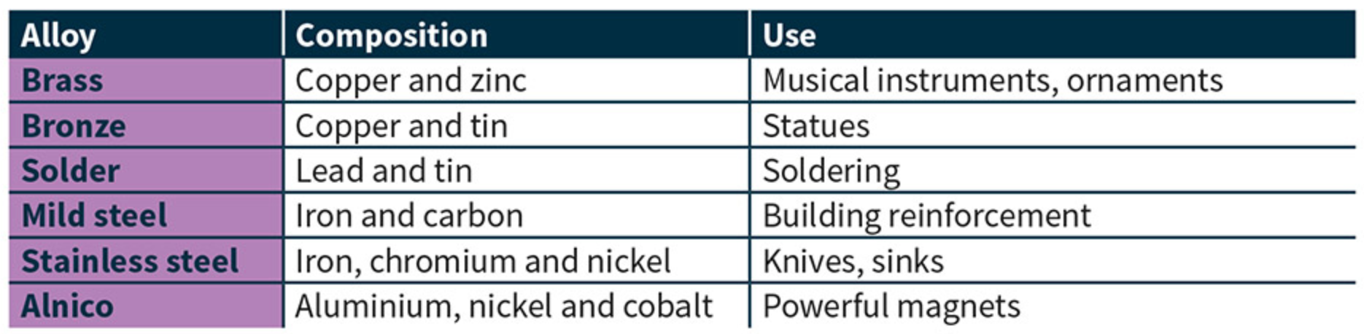
List everyday examples of an alloy

Slide 22


Slide 23
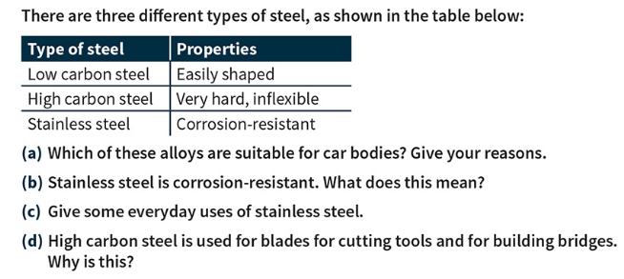

Slide 24
What are non metals
Notes:
Oxygen tank
Fertiliser n
Chlorine – swimming pool

Slide 25

Non metals
Non- metals have properties that are generally opposite to metals.

Slide 26
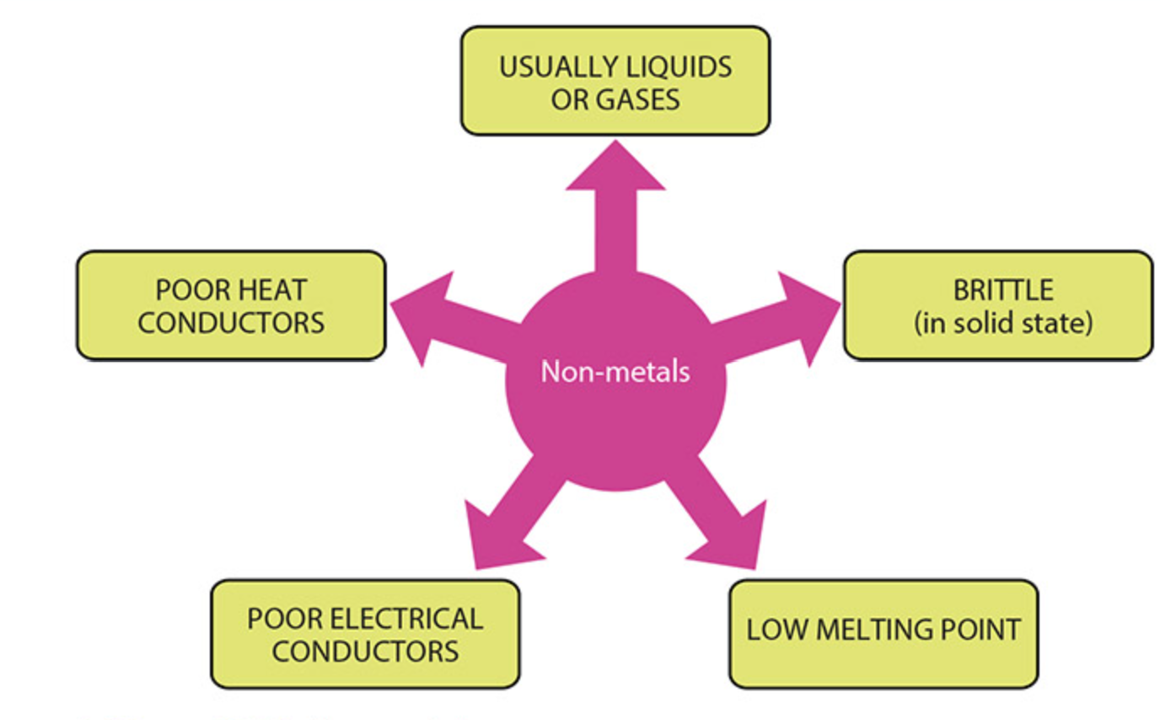
Properties of non- metals

Slide 27
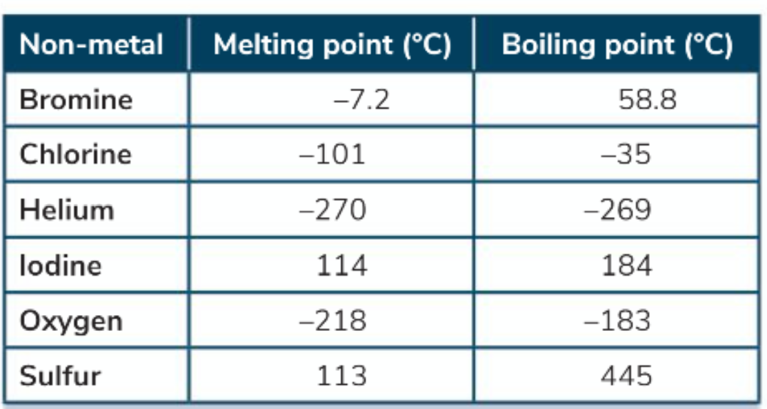
Melting and boiling point of non metals
Many non metals have low melting and boiling points.
They are liquid or gas at room temperature.

Slide 28
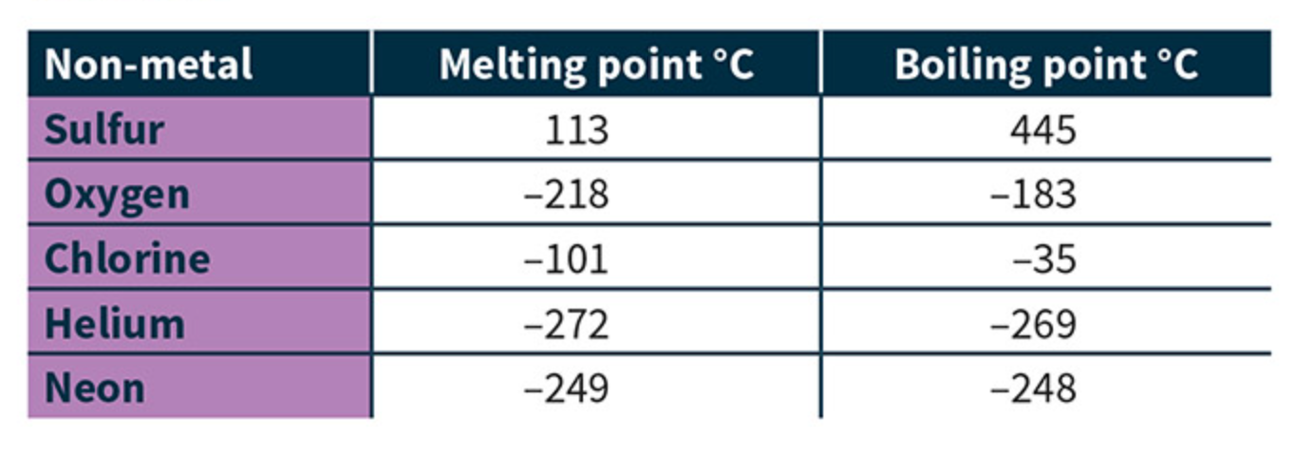
Melting & boiling point of non-metals
The forces that hold the particles together in a non-metal are weak, this means they melt and boil easily.

Slide 29

Where might non-metals be used in everyday objects list 5 examples
Notes:
Oxygen tank
Fertiliser n
Chlorine – swimming pool

Slide 30
Suggest a reason for the following
Bells are made from metal
The handle of a saucepan is often made of plastic
Electrical cables are made from copper
Gutter in our homes are made from plastic
Bridges are constructed from iron

Slide 31
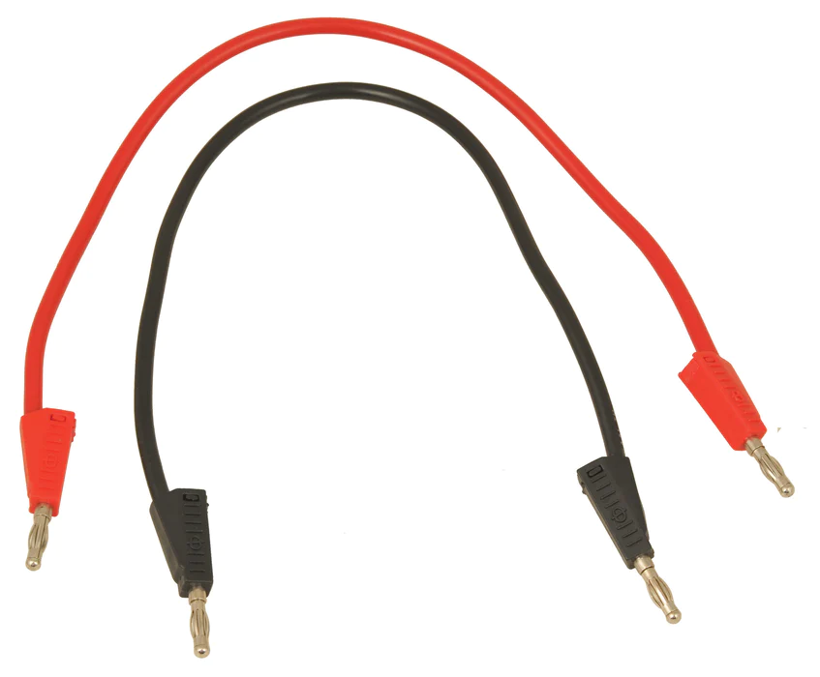
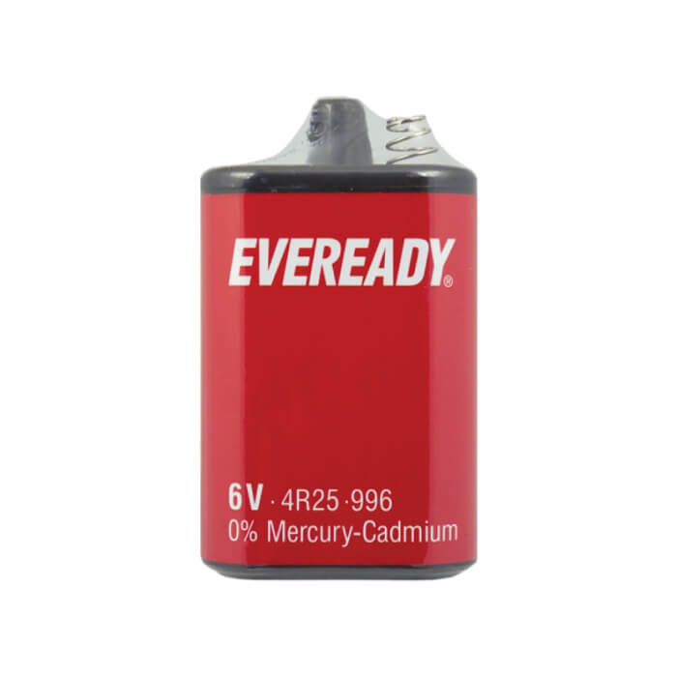
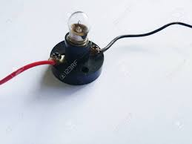
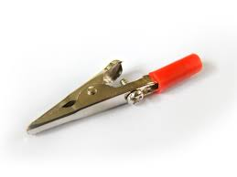
To discover the best material for conducting electricity
Equipment:
Bulb 2 Leads 2 Crocodile clips Battery

Slide 32
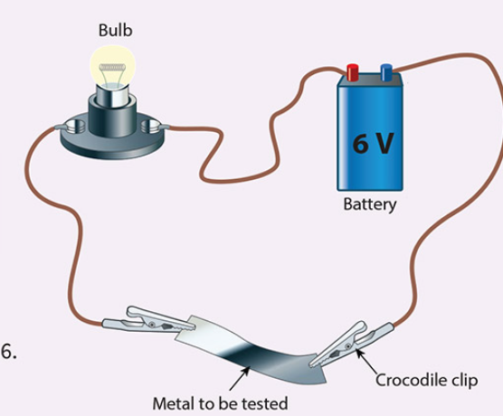

To discover the best material for conducting electricity
Set up the circuit as shown.
Place different materials between the crocodile clips one at a time.
Note which material is the best conductor of electricity.

Slide 33
To discover the best material for conducting electricity
Material | Prediction | Yes its conducted electricity | No, it did not conduct electricity
Lead in pencil
Tin foil
Copper
Glass
Sand paper
Wood

Slide 34
Questions to answer
What is a conductor?
From the experiment, name the material that conducts electricity.
Why you think these materials conduct electricity?
Name the energy transfer that you observed in your circuit

